Slide 1
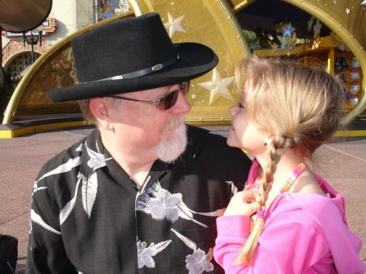

Slide 2
Lost Opportunities: A Decade of the OA Wars The 22nd Miriam Libbey Lecture
T. Scott Plutchak
UAB Lister Hill Library of the Health Sciences
Georgia Health Sciences Library Association
Atlanta
March 9, 2012

Slide 3
FRPAA

Slide 4
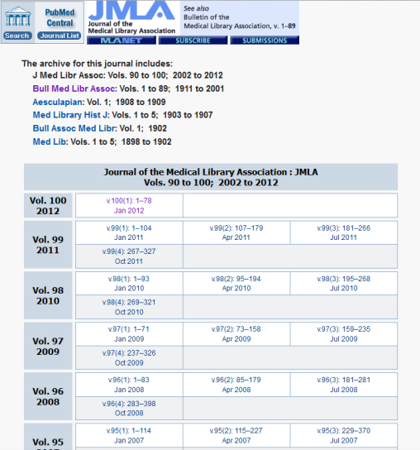
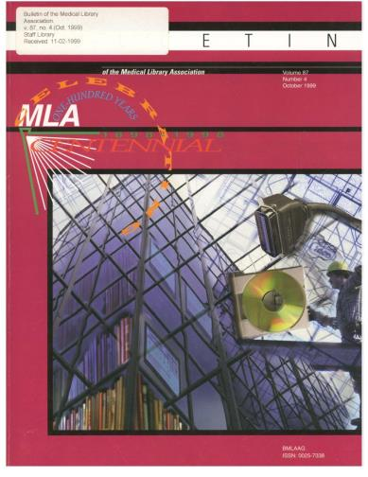
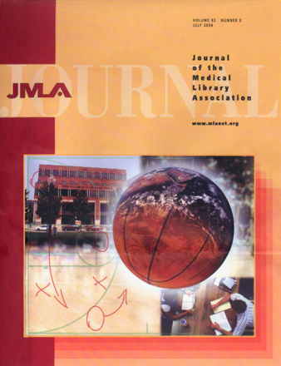
2000

Slide 5
2002

Slide 6
2004

Slide 7
2006

Slide 8
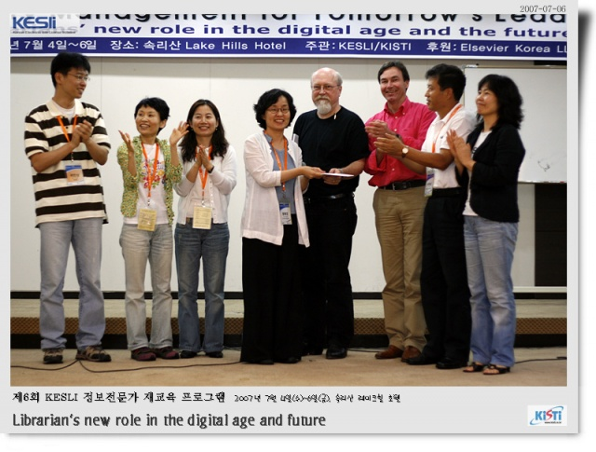
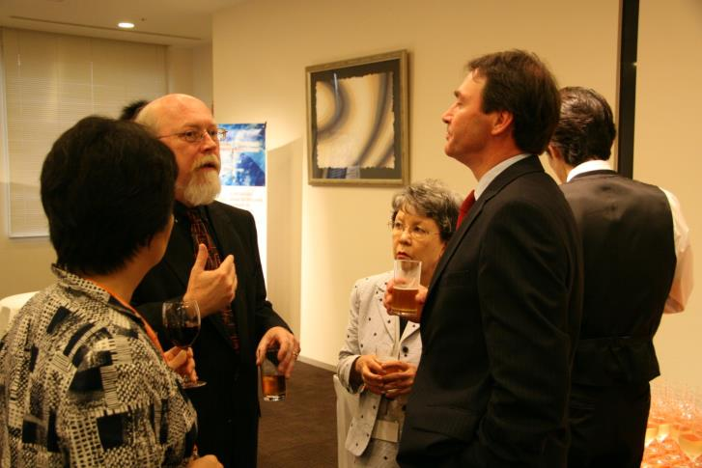
2007

Slide 9
2008

Slide 10
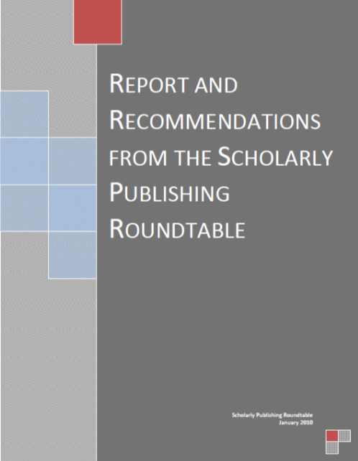
2009
House Science and Technology Committee/OSTP Roundtable on Public Access to Federal Research and Data:
The Scholarly Publishing Roundtable

Slide 11
The debate between these two extremes has been remarkably vitriolic, in part, perhaps, because neither side has been completely honest. … It was this nasty standoff in part that prompted the House Committee on Science, Space and Technology … to assemble a task force of stakeholders … to review the debate and present options. “No one was satisfied with the way this was going …” said Bart Gordon … former Science Committee chairman … “We … tried to do it outside the spotlight so people didn’t have to posture as much.”
New York Times, 2/27/12

Slide 12
Participants
Academia | Libraries | Publishers
John Vaughn (AAU, Chair) | Ann Okerson (Yale) | Y.S. Chi (Elsevier)
Richard McCarty (Vanderbilt) | T. Scott Plutchak (UAB) | Mark Patterson (PLoS)
David Campbell (Boston ) | Paul Courant (Michigan) | Fred Dylla (AIP)
Jim O’Donnell (Georgetown) |  | Crispin Taylor (ASPB)
Researchers: Phil Davis (Cornell), Carol Tenopir (Tennessee) and Don King (UNC)

Slide 13
Core recommendation
Each federal research funding agency should expeditiously but carefully develop and implement an explicit public access policy that brings about free public access to the results of the research that it funds as soon as possible after those results have been published in a peer-reviewed journal.
Notes:
What do scholars want? Access; Now; Unihibited; Search
Gov has responsibility to devlop and implement a public access policies ($45b)
Gov should exercise this responsibility in full collaboration with stakeholders

Slide 14
Additional Recommendations of Report
Agencies should work in full and open consultation with all stakeholders, as well as with OSTP, to develop their public access policies.
Agencies should establish specific embargo periods between publication and public access.
Policies should be guided by the need to foster interoperability.
Every effort should be made to have the version of record as the version to which free access is provided.

Slide 15
Policies should foster innovation in the research and educational use of scholarly publications.
Government public access policies should address the need to resolve the challenges of long-term digital preservation.
OSTP should establish a public access advisory committee.

Slide 16
12 of 14 members fully endorsed report’s recommendations

Slide 17
The America COMPETES Act (H.R. 5116): The America Creating Opportunities to Meaningfully Promote Excellence in Technology, Education, and Science Act!
principal provisions authorize increased funding for the NSF, DOE Office of Science, and NIST – National Institute of Standards and Technology
HSTC added a section of the bill directing OSTP to establish a Public Access working group under the National Science and Technology Council

Slide 18
Provisions:
coordinate the development of standards for research data and reports to achieve interoperability across Federal science agencies and science and engineering disciplines
coordinate Federal agency programs that support research and education to ensure preservation and stewardship of all forms of digital research data, including scholarly publications
work with international counterparts to maximize interoperability between US and international research databases and repositories
solicit input from, and collaborate with, non-Federal stakeholders

Slide 19
Signed into law in December of 2010
OSTP/RFI process 12/11 to 1/12
Report expected this spring

Slide 20
We can do better than FRPAA
Require grantees to publish in OA journals
Funding
Standards
Submit metadata that links back to VoR
Develop standards for interoperability and data-mining
Emphasize robust archiving/preservation strategies

Slide 21
What Have I Learned?
Most people in publishing believe that their work is in the interest of the advancement of science and the public good
Publishing is an extremely diverse industry
Few people in publishing are opposed to Open Access in principle
Most people in publishing oppose government mandates
Most people in publishing are eager to work with librarians on solutions

Slide 22
While the library community focuses on FRPAA…
Highwire hosts over 2,127,016 freely available full-text articles
The large commercial publishers are all experimenting with OA models
Numerous PLoS One clones are debuting

Slide 23
My biggest fear…
The scholarly communication world will continue to shift to OA models, but will continue to be dominated by the large for-profit publishers
And the contributions that librarians could be making will be absent

Slide 24
For the bright future of
scientific communication…
Cultivating partnerships is essential

Slide 25
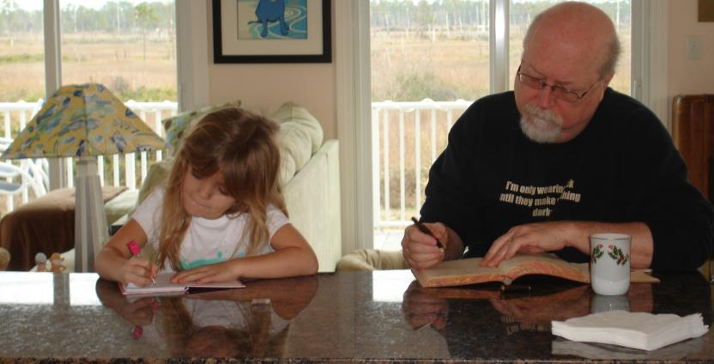
tscott@uab.edu
tscott.typepad.com

